Slide 1

BRITISH AIRWAYS
SOLELY FOR PURPOSES OF FORAGE WORK EXPERIENCE
ASMITA MONDAL
Skytrax Airline Review Analysis

Slide 2

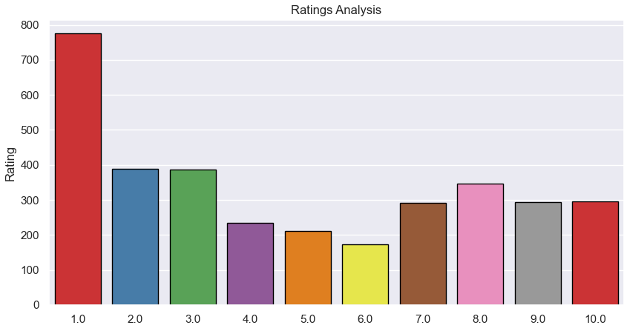
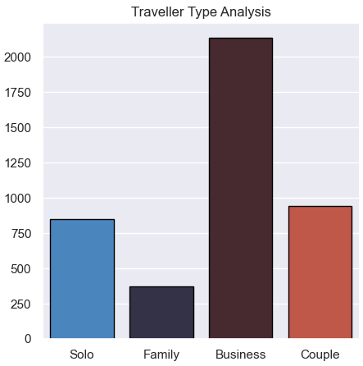
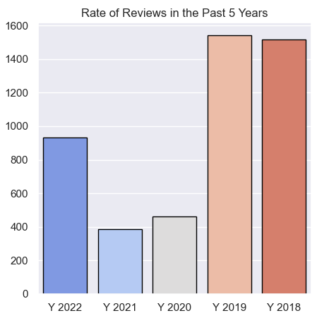
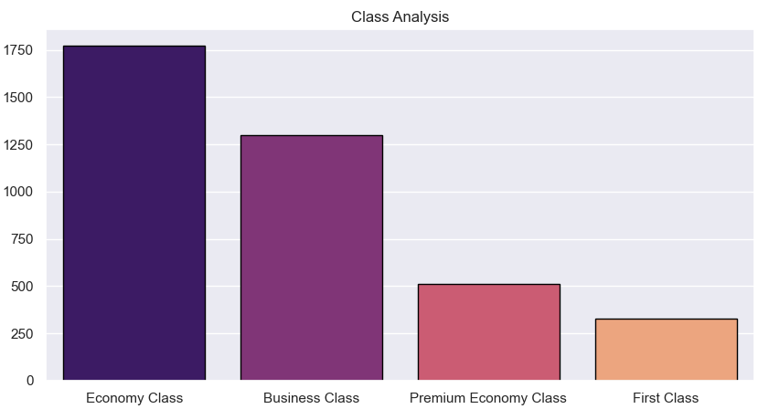
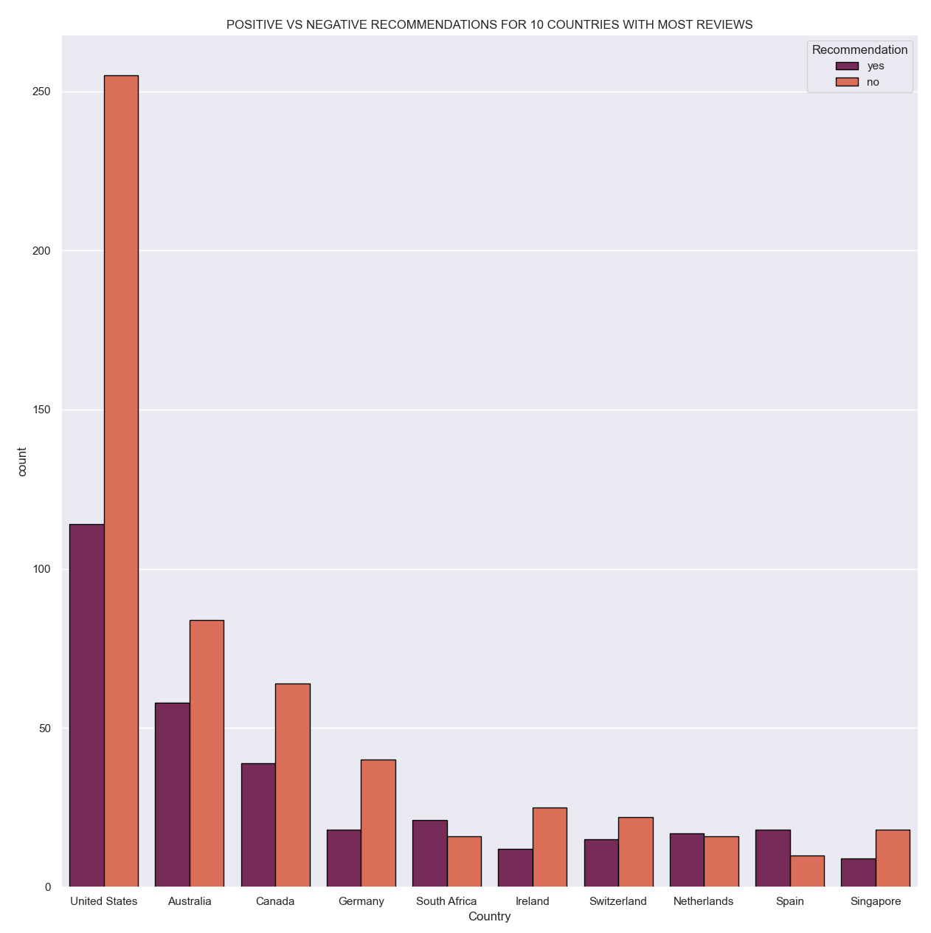
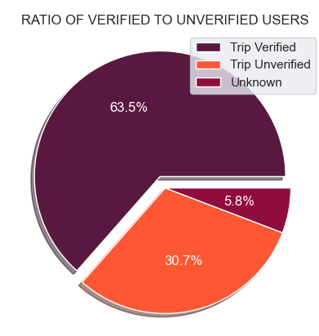
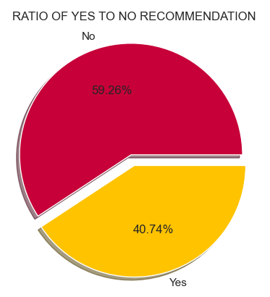
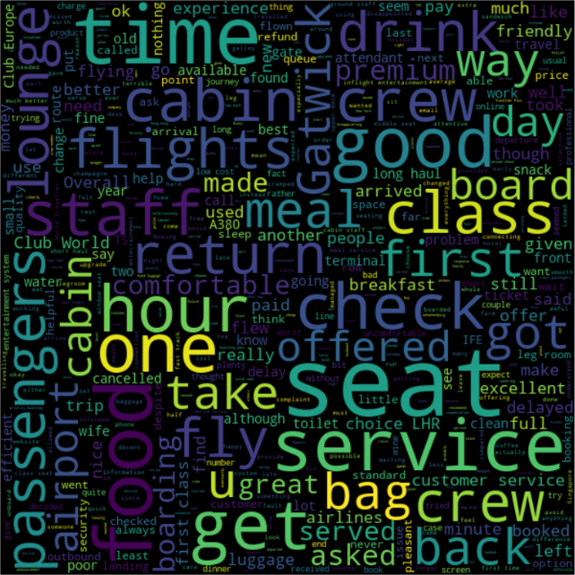



Key Findings
69
Participating Countries
4.75
Average Rating
3400
Reviews
Insights:
Number of Negative reviews exceeds that of Positive reviews
Most reviews posted come from Verified Users
Passengers prefer Economy class and travel mostly for Business purposes
Maximum ratings fall under 1 Star Review
Passengers mostly talk about the cabin crew, seats, class, meals, lounge, food, customer service, and classes
Insights:
10 star: Customers have taken round trips, described service as great, found airway excellent despite hearing negative reviews with efficient check ins.
9,8,7 stars: Most passengers were first timers travelling in Premium Economy or Business class.
7,6,5 stars: Several return trips with overall service considered as poor.
1 star: Described as worst experience in terms of customer services and booking cancellations.
Highest Contributors: United Kingdom
TOTAL REVIEWS: 2142 YES: 883 NO: 1259

